Slide 1
Determinants
INTRODUCTION TO DETERMINANTS

Slide 2
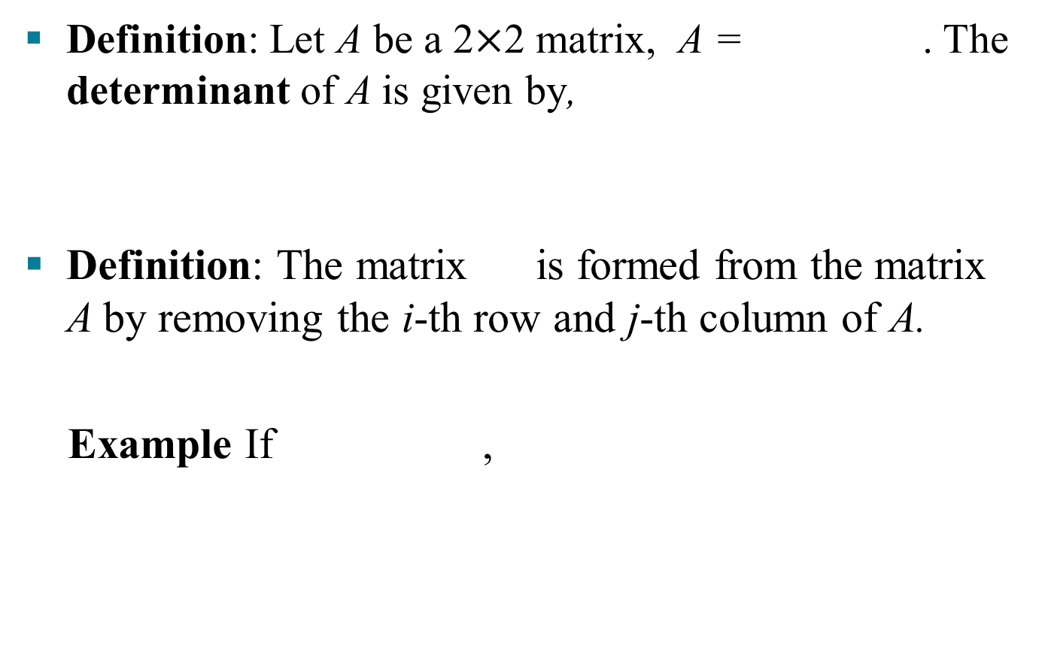
INTRODUCTION TO DETERMINANTS
Definition: Let A be a 2$×$2 matrix, A = . The determinant of A is given by,
Definition: The matrix is formed from the matrix A by removing the i-th row and j-th column of A.
Example If ,
then

Slide 3

INTRODUCTION TO DETERMINANTS
Definition: For n ≥ 2, the determinant of an $n×n$ matrix A = [a_{ij}] is given by
$$\text{det}{\text{A}=\text{a}11\text{det}{\text{A}11−\text{a}12\text{det}⁡\text{A}12+…+\left(−1\right)1+\text{n}\text{a}\text{1}\text{n}det⁡\text{A}1n}}$$
$=\sum_{\text{j}=1}^{\text{n}}{\left(−1\right)1+\text{j} \text{a}\text{1}\text{j}\text{det} \text{A}\text{1}\text{j}}$

Slide 4
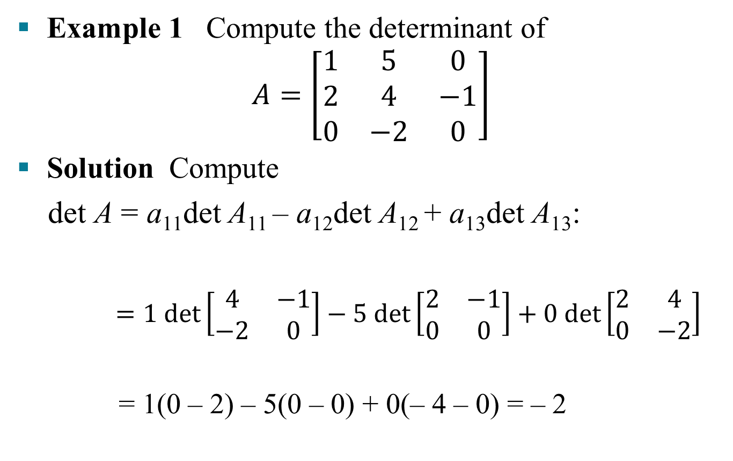
INTRODUCTION TO DETERMINANTS
Example 1 Compute the determinant of
$$A=\left[\begin{matrix}1 & 5 & 0 \\ 2 & 4 & −1 \\ 0 & −2 & 0\end{matrix}\right]$$
Solution Compute
det A = a₁₁det A₁₁ – a₁₂det A₁₂ + a₁₃det A₁₃:
$=1 det\left[\begin{matrix}4 & −1 \\ −2 & 0\end{matrix}\right]−5 det\left[\begin{matrix}2 & −1 \\ 0 & 0\end{matrix}\right]+0 det\left[\begin{matrix}2 & 4 \\ 0 & −2\end{matrix}\right]$
= 1(0 – 2) – 5(0 – 0) + 0(– 4 – 0) = – 2

Slide 5
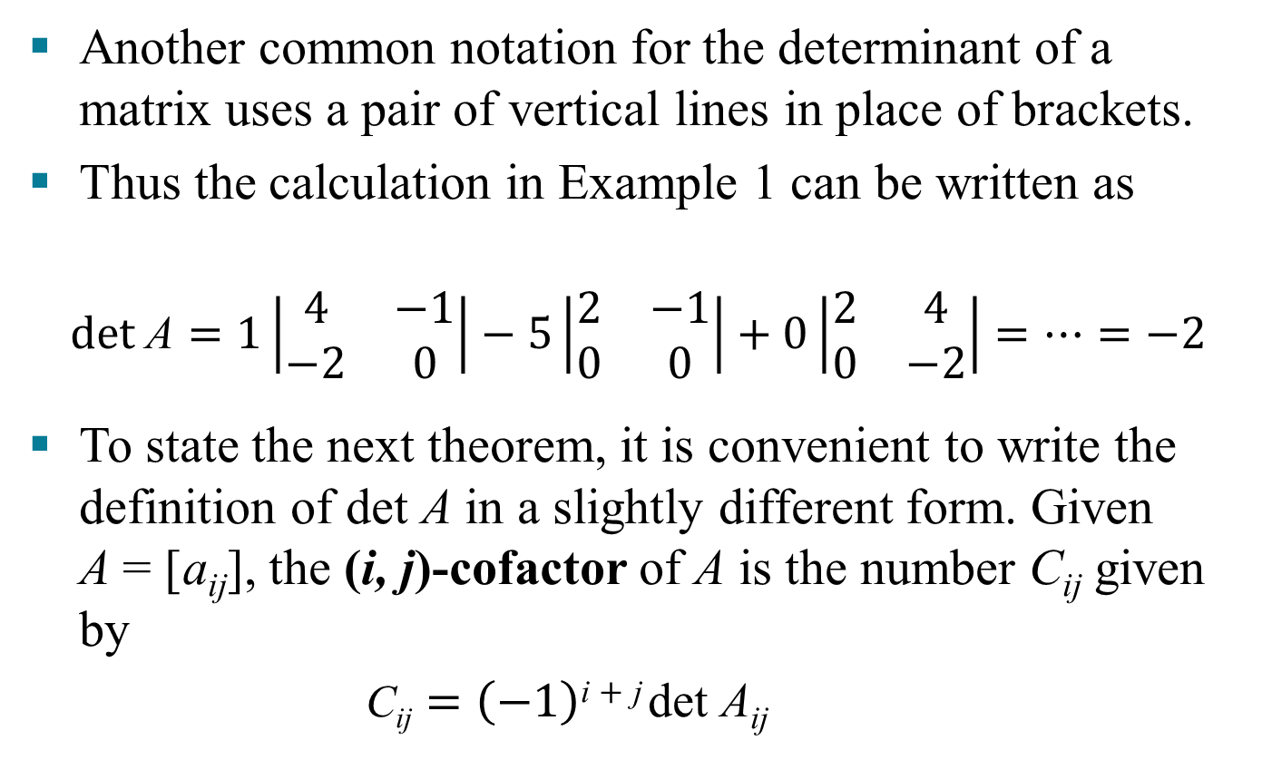
INTRODUCTION TO DETERMINANTS
Another common notation for the determinant of a matrix uses a pair of vertical lines in place of brackets.
Thus the calculation in Example 1 can be written as
$$det \text{A}=1\left|\begin{matrix}4 & −1 \\ −2 & 0\end{matrix}\right|−5\left|\begin{matrix}2 & −1 \\ 0 & 0\end{matrix}\right|+0\left|\begin{matrix}2 & 4 \\ 0 & −2\end{matrix}\right|=…=−2$$
To state the next theorem, it is convenient to write the definition of det A in a slightly different form. Given A = [a_{ij}], the (i, j)-cofactor of A is the number C_{ij} given by
$\text{C}\text{ij}=\left(−1\right)\text{i}+\text{j} \text{det} \text{A}\text{ij}$

Slide 6
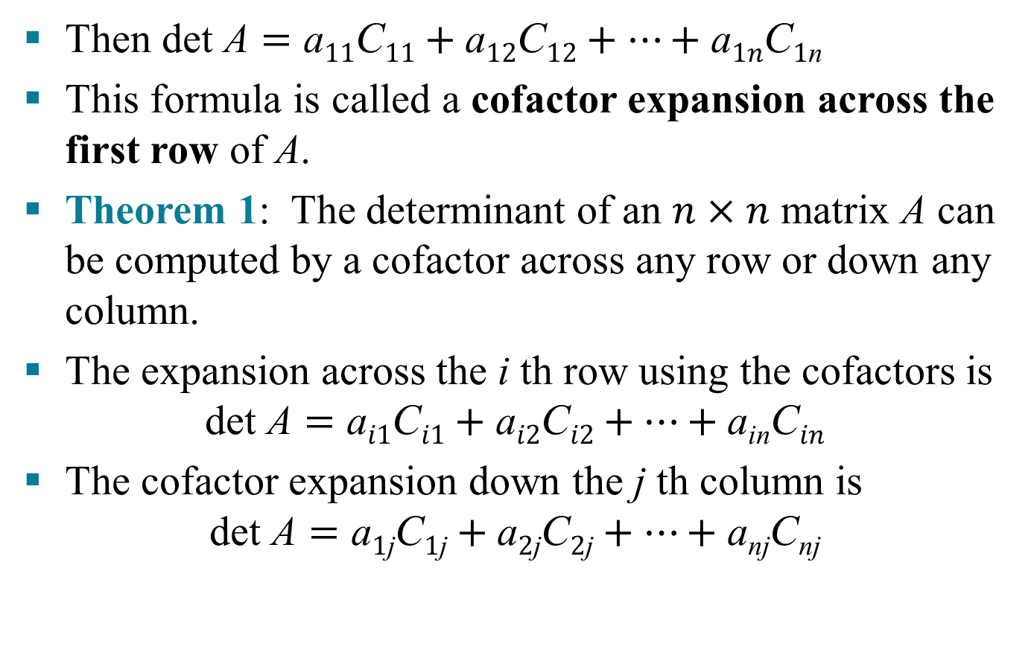
INTRODUCTION TO DETERMINANTS
Then $\text{det} \text{A}=\text{a}11\text{C}11+\text{a}12\text{C}12+…+\text{a}1n\text{C}1\text{n}$
This formula is called a cofactor expansion across the first row of A.
Theorem 1: The determinant of an $n×n$ matrix A can be computed by a cofactor across any row or down any column.
The expansion across the i th row using the cofactors is
$$\text{det} \text{A}=\text{a}i1\text{C}i1+\text{a}i2\text{C}i2+…+\text{a}\text{in}\text{C}in$$
The cofactor expansion down the j th column is
$$\text{det} \text{A}=\text{a}1\text{j}\text{C}1\text{j}+\text{a}2\text{j}\text{C}2\text{j}+…+\text{a}\text{n}\text{j}\text{C}\text{n}\text{j}$$

Slide 7
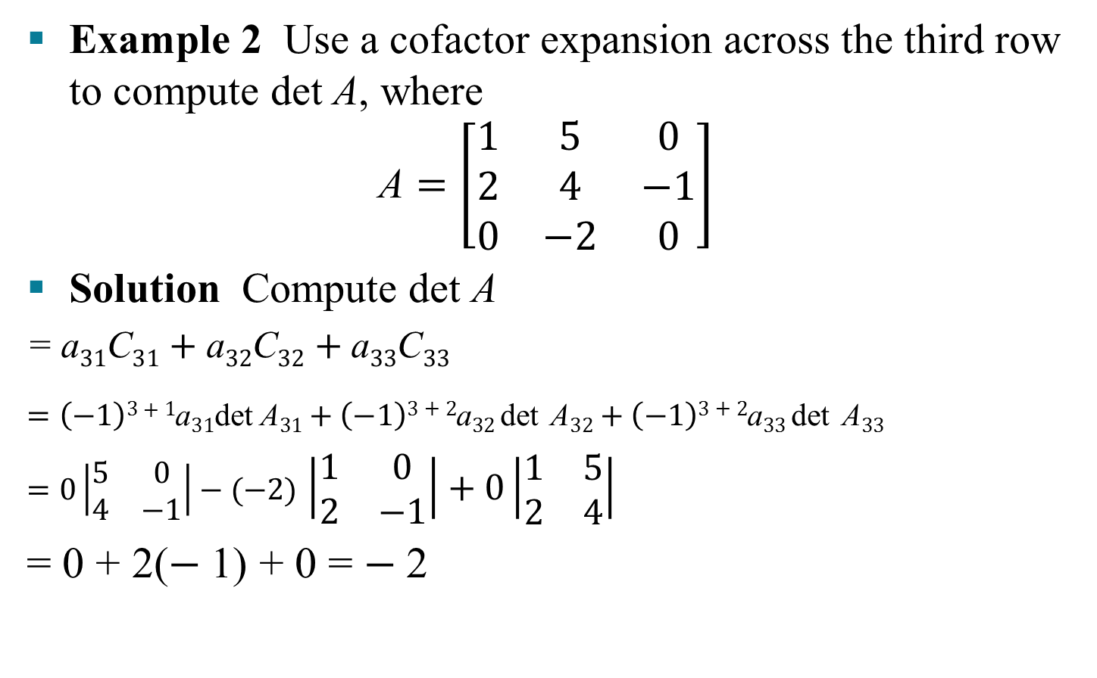
INTRODUCTION TO DETERMINANTS
Example 2 Use a cofactor expansion across the third row to compute det A, where
$$\text{A}=\left[\begin{matrix}1 & 5 & 0 \\ 2 & 4 & −1 \\ 0 & −2 & 0\end{matrix}\right]$$
Solution Compute det A
=$\text{a}31\text{C}31+\text{a}32\text{C}32+\text{a}33\text{C}33$
$$=\left(−1\right)3+1\text{a}31\text{det} \text{A}31+\left(−1\right)3+2\text{a}32\text{det}{ \text{A}32+\left(−1\right)3+2\text{a}33\text{det}{ \text{A}33}}$$
$=0\left|\begin{matrix}5 & 0 \\ 4 & −1\end{matrix}\right|−(−2)$ $\left|\begin{matrix}1 & 0 \\ 2 & −1\end{matrix}\right|+0\left|\begin{matrix}1 & 5 \\ 2 & 4\end{matrix}\right|$
= 0 + 2($−$1) + 0 = $−$2

Slide 8
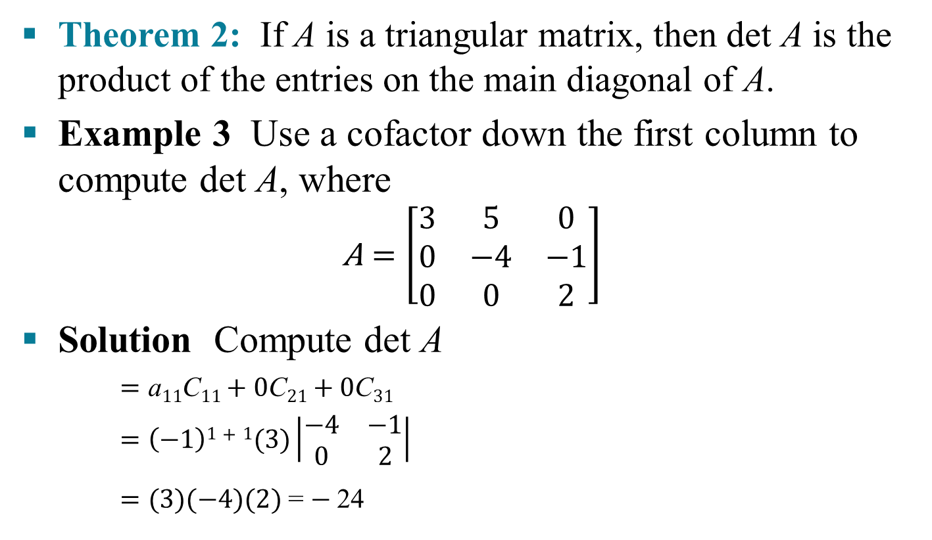
INTRODUCTION TO DETERMINANTS
Theorem 2: If A is a triangular matrix, then det A is the product of the entries on the main diagonal of A.
Example 3 Use a cofactor down the first column to compute det A, where
$$\text{A}=\left[\begin{matrix}3 & 5 & 0 \\ 0 & −4 & −1 \\ 0 & 0 & 2\end{matrix}\right]$$
Solution Compute det A
$=\text{a}11\text{C}11+\text{0}\text{C}21+\text{0}\text{C}31$
$=\left(−1\right)1+1(3)\left|\begin{matrix}−4 & −1 \\ 0 & 2\end{matrix}\right|$
$=(3)(−4)(2)$= $−$24

Slide 9
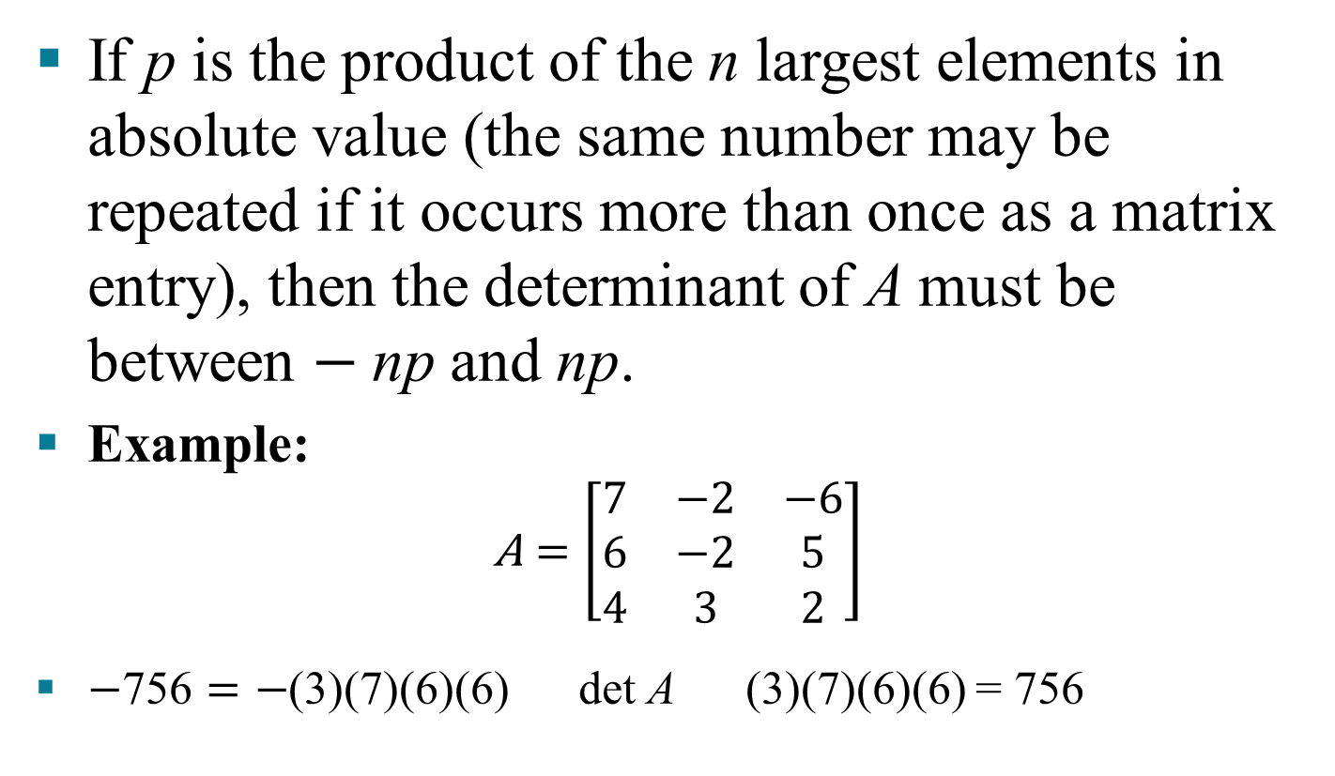
REASONABLE ANSWERS
If p is the product of the n largest elements in absolute value (the same number may be repeated if it occurs more than once as a matrix entry), then the determinant of A must be between $−$np and np.
Example:
$$\text{A}=\left[\begin{matrix}7 & −2 & −6 \\ 6 & −2 & 5 \\ 4 & 3 & 2\end{matrix}\right]$$
$−\text{7}\text{56}=−$(3)(7)(6)(6) det A (3)(7)(6)(6) = 756

